Slide 1
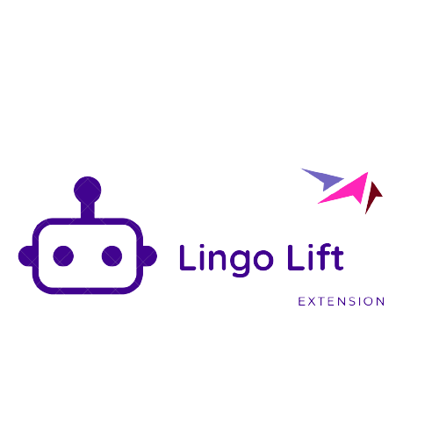
Lingo Lift: Text Driven Paraphrasing Tool
Muhammad Ahmed Naseer
Presented by:

Slide 2
Roadmap
Demo
My Approach
Problem statement
3
5
1
2
Model Working

Slide 3
Problem Statement
1
Lack of Variation in Text
Time-Consuming Manual Paraphrasing
Difficulty in Maintaining Original Meaning
Plagiarism Concerns

Slide 4
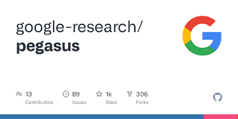
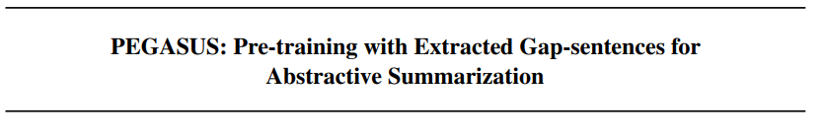
proposed by Google AI which is supposed to appear in ICML 2020.

Slide 5
Core idea : Abstract Summarization
Gap Sentences Generation (GSG)
Two Approaches
Masked Language Model (MLM)

Slide 6
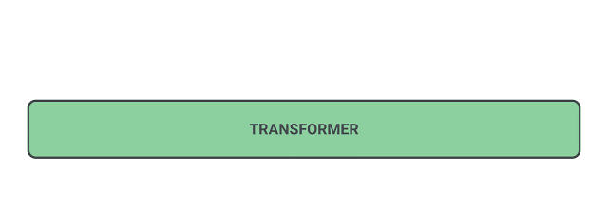
Gap Sentences Generation (GSG)

Slide 7
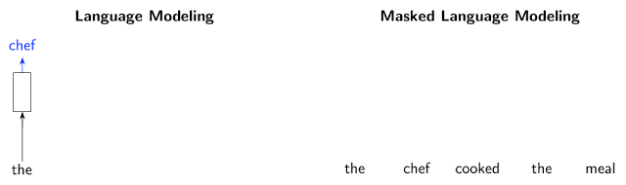
Masked Language Model (MLM)

Slide 8
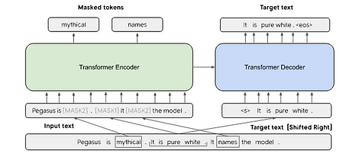
Combined

Slide 9
My Approach

Slide 10
Our Approach
Fine Tune
fine tune Pegasus model for paraphrasing
Try to fine tune pegasus-cnn_dailymail model
By using samSum dataset contain 16k conversations with summaries.
Training
num_train_epochs=1, warmup_steps=500,
per_device_train_batch_size=1, per_device_eval_batch_size=1,
weight_decay=0.01, logging_steps=10,
evaluation_strategy='steps', eval_steps=500, save_steps=1e6,
gradient_accumulation_steps=16

Slide 11
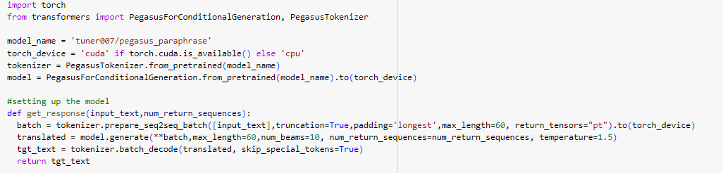
Resources Issues
Hugging face
Switch to hugging face, for pre-trained model named Pegasus_paraphrase
Model

Slide 12
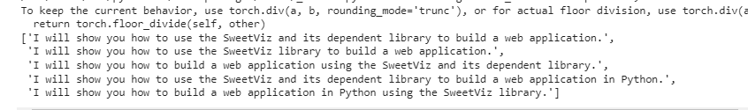
Sample text
text = "I will be showing you how to build a web application in Python using the SweetViz and its dependent library."

Slide 13
Microsoft Edge Extenstion
HTML, CSS, JavaScript
Fast API

Slide 14
Three different Models
Peagasus-
paraphrase
Keybert
wordNet

Slide 15
Work-Flow of Extension
Pegasus model
Paraphrased
output
Paragraph
Keywords
keybert
synonyms
wordnet

Slide 16
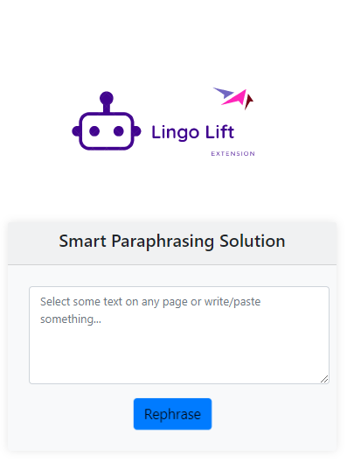


Deployment

Slide 17
Extentsion Demo
2

Slide 18
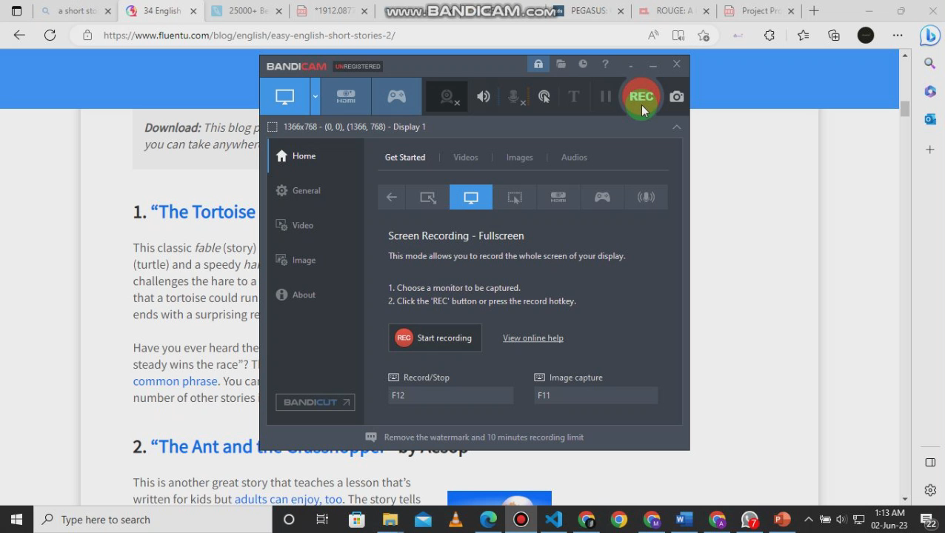

Slide 19
Thanks!

